Slide 1

URINE BIOMARKERS ANALYSIS FOR PANCREATIC CANCER DIAGNOSIS
By Azlamiya T A

Slide 2
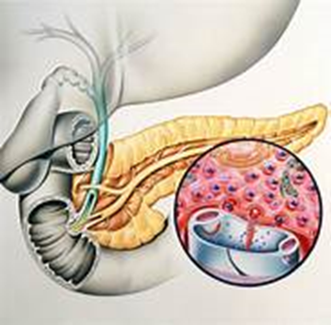
PANCREATIC CANCER
Pancreatic cancer is a malignant tumor that develops in the pancreas.
It is one of the most aggressive and deadly types of cancer, with a high mortality rate. Pancreatic cancer often remains undetected until it reaches advanced stages, making it difficult to treat effectively. Certain factors that increase the risk of developing pancreatic cancer include age, smoking, obesity, family history of pancreatic cancer or other related syndromes, chronic pancreatitis, diabetes, and certain genetic mutations.
Changes in the DNA of pancreatic cells begin to grow abnormally. These cells divide more rapidly than healthy cells do and continue to accumulate, forming a lump or mass. Cells may spread to nearby abdominal tissues, lymph nodes, blood vessels, and other organs, like the liver.
Most pancreatic cancer begins in the cells that line the ducts of the pancreas. This type of cancer is called Pancreatic Ductal Adenocarcinoma or pancreatic exocrine cancer and Cancer can form in the hormone-producing cells or the neuroendocrine cells of the pancreas. These types of cancer are called Pancreatic Neuroendocrine Tumors, islet cell tumors or pancreatic endocrine cancer.

Slide 3
OBJECTIVES
To conduct Exploratory Data Analysis (EDA) on the dataset containing urinary biomarkers and plasma levels to gain insights into the data.
To develop a classification model using a Support Vector Machine (SVM), Random Forest, Logistic Regression, and K Nearest Neighbors (KNN) to distinguish between Non-Cancerous and Cancerous cases based on the urinary biomarkers and plasma levels.
To compare Support Vector Machine (SVM), Random Forest, Logistic Regression, and K Nearest Neighbors (KNN) models ability to classify Non-Cancerous and Cancerous cases based on the urinary biomarkers and plasma levels.
To determine the most important urinary biomarkers and plasma levels in classifying Non-Cancerous and Cancerous cases, derived from the best model’s feature ranking analysis.

Slide 4
MATERIALS AND METHODS
DATA COLLECTION
This study made use of the open-access website Kaggle for the Kaggle Urinary Biomarkers for Pancreatic Cancer (2020) dataset (https://www.kaggle.com/datasets/johnjdavisiv/urinary-biomarkers-for-pancreatic-cancer), which was collected by Debernardi et al.
DATASET
The Urinary Biomarkers dataset used in this study, samples were collected from BPTB: Barts Pancreas Tissue Bank, London, UK; ESP: Spanish National Cancer Research Centre, Madrid, Spain; LIV: Liverpool University, UK and UCL: University College, London, UK. The dataset includes samples from 590 people. The dataset has three groups: Healthy controls, Patients with Chronic pancreatitis, and Patients with Pancreatic Ductal Adenocarcinoma.
The key features are four urinary biomarkers: LYVE1, REG1B, REG1A, TFF1, Urine Creatinine, and Plasma CA19-9.
LYVE1 – Urinary levels of Lymphatic vessel endothelial hyaluronan receptor 1
REG1B – Urinary levels of Regenerating islet-derived 1 beta protein
REG1A – Urinary levels of Regenerating islet-derived 1 alpha protein
TFF1 – Urinary levels of Trefoil Factor 1 protein
Plasma CA19-9 – Blood plasma levels of CA19-9 monoclonal antibodies
Urine Creatinine – Blood levels of plasma creatinine

Slide 5
SAMPLE DATASET

Slide 6
TOOLS FOR ANALYSIS
Support Vector Machine (SVM)
Random Forest
Logistic Regression
K Nearest Neighbors (KNN)
TOOLS FOR COMPARISON
Confusion Matrix
Accuracy, Precision, Recall, and F1 Score
ROC-AUC Curve
The process is done using Python programming.

Slide 7

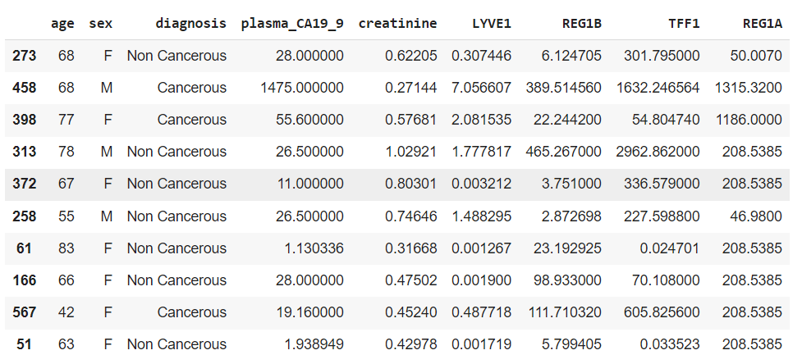
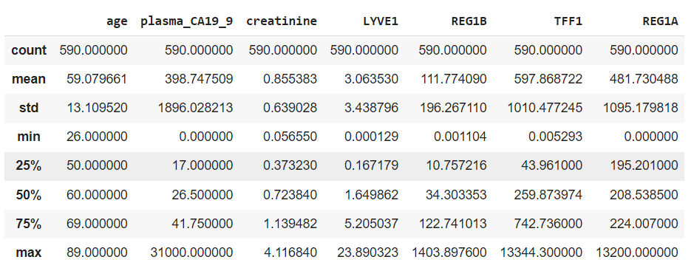
RESULTS AND DISCUSSION
Description of numerical variables
Patients with age ranges from 26 to 89 years are in the dataset and the creatinine levels having mean and median almost same shows normal distribution but, other variables shows high variability between mean and maximum value.
The sample dataset after removing the unwanted features, making two classes in diagnosis: Non-Cancerous (391) and Cancerous (199) cases, and replacing missing values with the median value.

Slide 8
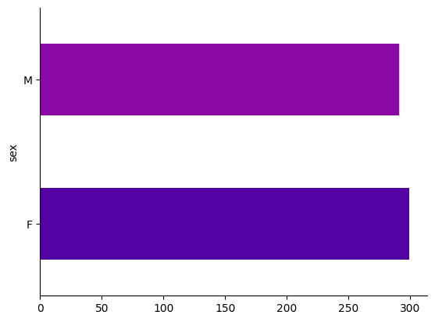
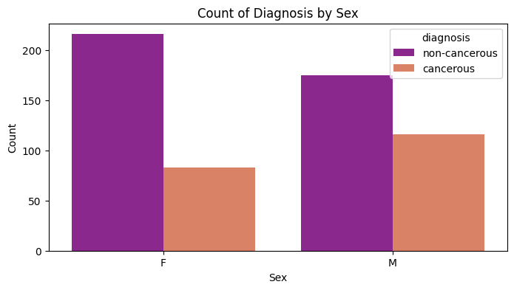
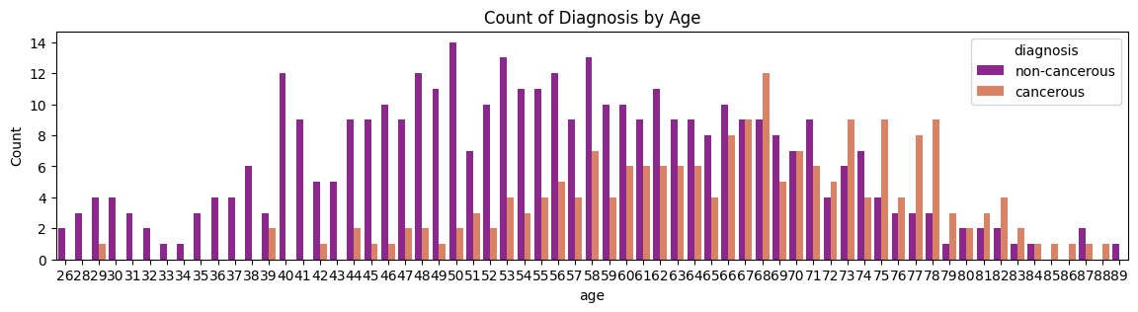
The count of females is slightly higher than the count of males and the dataset shows an imbalance in the count of cancer and non-cancer cases.
In the count plot for diagnosis by sex, the count of the males with cancer is higher than the females with cancer. Cancer cases are seen among individuals aged 40 to 84 years, which is high between the age of 58 to 78 years.

Slide 9
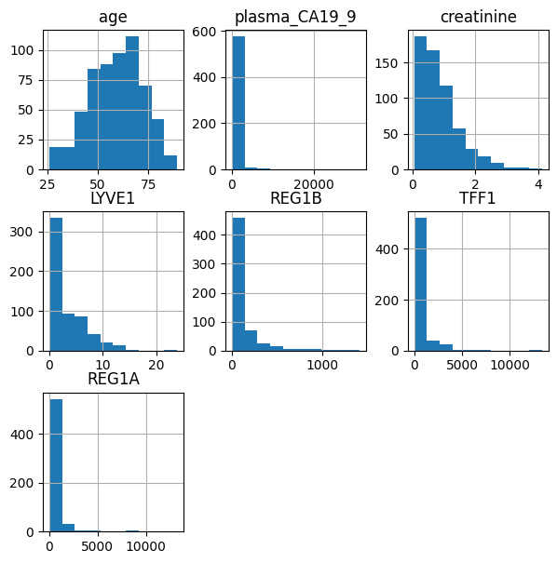
Distributions of numerical variables
Age relatively symmetric and normally distributed with closer mean and median values. But, the other urine biomarkers LYVE1, REG1B, TFF1, REG1A, Creatinine and plasma CA19-9 exhibits a right-skewed distribution with a mean much lower than the maximum value.

Slide 10
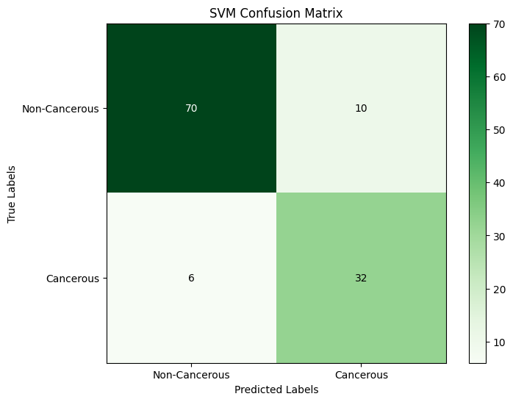
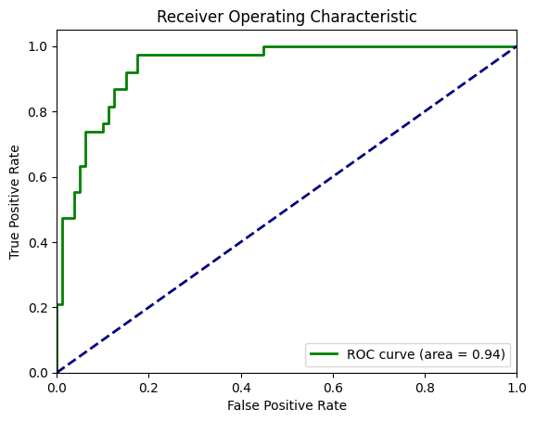
Classification of models
Support Vector Machine (SVM)
Support vector machine (SVM) is a supervised machine learning technique which creates a decision boundary called hyperplane that separates two classes in 2 dimensional space. The maximum distance between the boundary and the closest data point in each class is the maximum-margin hyperplane or the optimal hyperplane.
Support Vector Machine (SVM) Metrics:
Accuracy: 0.864406779661017
Precision: 0.8698016227008197
Recall: 0.864406779661017
F1 Score: 0.866058235549761

Slide 11
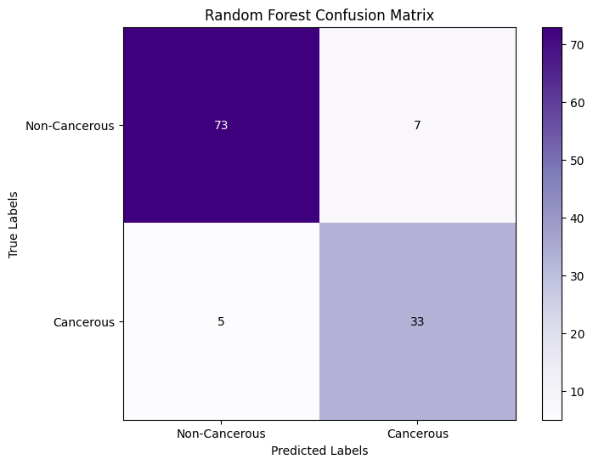
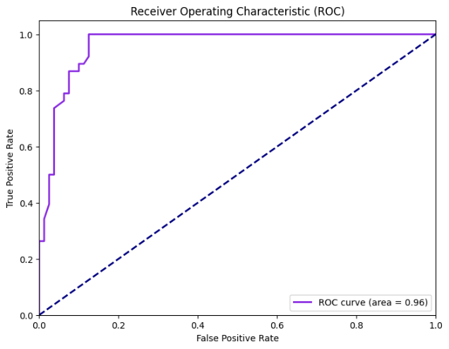
Random Forest
It is a particular kind of ensemble learning methodology and is employed in classification and regression problems. Random Forest works by building a large number of decision trees by lowering variance, during the training period and it outputs the class that represents the mean of all class of all individual trees.
Random Forest Metrics:
Accuracy: 0.8983050847457628
Precision: 0.9001847023033464
Recall: 0.8983050847457628
F1 Score: 0.8989652270064199

Slide 12
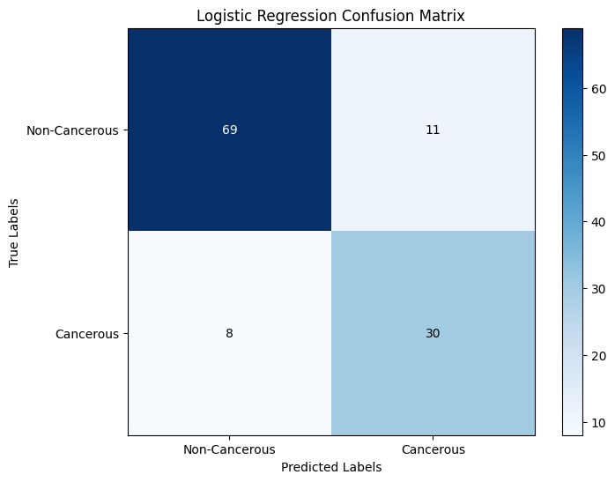
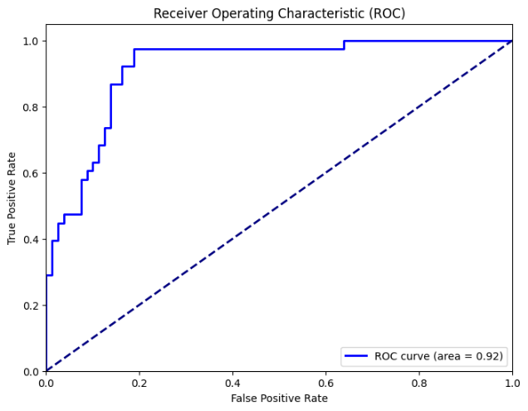
Logistic Regression
One of the most often used Machine Learning algorithms within the Supervised Learning category is logistic regression. It is employed to address classification issues. Instead of fitting a regression line, logistic regression uses an "S"-shaped logistic function (sigmoid function), which forecasts two maximum values (0 or 1).
Logistic Regression Metrics:
Accuracy: 0.8389830508474576
Precision: 0.8431626248906116
Recall: 0.8389830508474576
F1 Score: 0.840501956197038

Slide 13
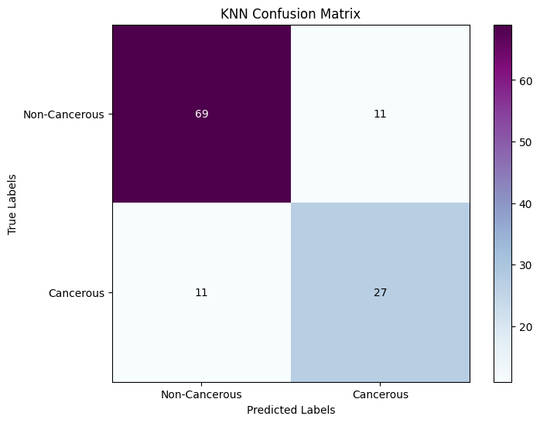
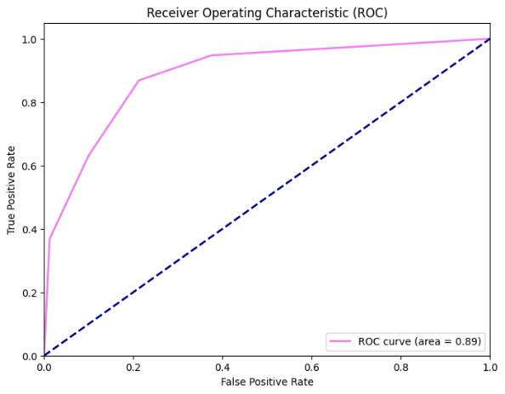
K Nearest Neighbor (KNN)
KNN is a lazy prediction technique. KNN assumes that similar things are near to each other. Many data points which are similar are very near to each other. KNN helps to group new work based on similarity measures. KNN algorithm records all the records and classifies them according to their similarity measure.
K Nearest Neighbor (KNN) Metrics:
Accuracy: 0.8135593220338984
Precision: 0.8135593220338984
Recall: 0.8135593220338984
F1 Score: 0.8135593220338984

Slide 14
Comparison of models
Models | F1 Score | AUC Value
Support Vector Machine (SVM) | 87% | 0.94
Random Forest | 90% | 0.96
Logistic Regression | 84% | 0.92
K Nearest Neighbor (KNN) | 81% | 0.89
Comparing the models, the random forest model has the highest F1 score and AUC value. Hence Random Forest is the best model for diagnosing whether the patient is cancerous or non-cancerous.

Slide 15
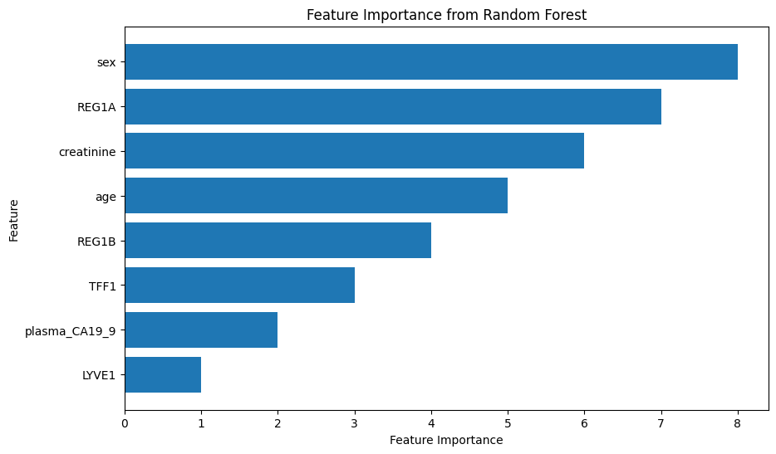
Most important urinary biomarkers and plasma levels
Feature Ranking:
---------------------
1. LYVE1
2. Plasma CA19-9
3. TFF1
4. REG1B
5. age
6. creatinine
7. REG1A
8. sex
---------------------
The urine biomarker LYVE1 has the highest rank and thereafter comes the Plasma CA19-9, TFF1, and REG1B levels. Where LYVE1 level plays a major role in the development of malignant tumors and lymphatic vessel maintenance. Plasma CA19-9 is the level of CA19-9 monoclonal antibodies in the blood plasma of patients.

Slide 16
CONCLUSION
The study aimed to determine the optimal classification model and to identify the most influential features in distinguishing between Patients without cancer and Patients with Pancreatic Ductal Adenocarcinoma. A dataset consisting of urinary biomarkers and plasma levels from 590 individuals were analyzed, including 391 Non-Cancerous and 199 Cancerous.
Classification was conducted using Support Vector Machine (SVM), Random Forest, Logistic Regression, and K Nearest Neighbor (KNN) models, and their performances were compared. The results indicated that the Random Forest model provided superior classification F1 Score for distinguishing between the two groups. Performance metrics such as Accuracy, Precision, Recall, and F1 Score and ROC-AUC Curve were utilized to evaluate and compare the models. There the Random Forest model exhibits 90% of F1 Score and 0.96 of AUC Value thus, it shows the highest overall performance. Therefore, it was selected as the preferred model for classification.
Then, the best model for classification Random Forest is employed to determine the most influential feature in the early diagnosis of pancreatic cancer. A feature importance plot was generated based on the coefficients derived from Random Forest, LYVE1 is identified as the key variable that significantly contribute to the predictive accuracy of the model.

Slide 17
THANK YOU

